Slide 1





Where We've Been and Where We're Going at rOpenSci
Peer-Reviewing R Code:
Noam Ross, UserR! 2020
noamross
@
Slides/Links: bit.ly/NoamUseR
Notes:
I'm Noam. I'm an ecologist at EHA.
Research at the confluence of conservation and public health, emerging inf. dis
Field ecologists, public health specialists, to our large + growing m&a team, and software engineering to turn our models into apps, and do large-scale ML for global disease surveillance.

Slide 2
Building technical and community infrastructure for R to support open, reproducible science
@rOpenSci
ropensci.org
Notes:
An organization that...
"Build open-source software, build community" (some themes from JD, Ricardo, Sean + Mike)
Fellowships for those who want to push the limits of tools
Hackathons
Mostly, write, incubate, maintain, lot and lots of packages to connect scientists with data sources and fill holes in reproducibility and data cycle.

Slide 3
12 Leadership and Staff
166 forum posters
491 chat members
59 blog authors
284 code contributors last year
117 of whom made their first contribution in the past year
A developer community with porous borders
Notes:
An organization that...
"Build open-source software, build community" (some themes from JD, Ricardo, Sean + Mike)
Fellowships for those who want to push the limits of tools
Hackathons
Mostly, write, incubate, maintain, lot and lots of packages to connect scientists with data sources and fill holes in reproducibility and data cycle.

Slide 4
400 Packages
170 peer-reviewed
122 cited 863 times
Making tools to accelerate science and make software first-class output
Notes:
An organization that...
"Build open-source software, build community" (some themes from JD, Ricardo, Sean + Mike)
Fellowships for those who want to push the limits of tools
Hackathons
Mostly, write, incubate, maintain, lot and lots of packages to connect scientists with data sources and fill holes in reproducibility and data cycle.

Slide 5
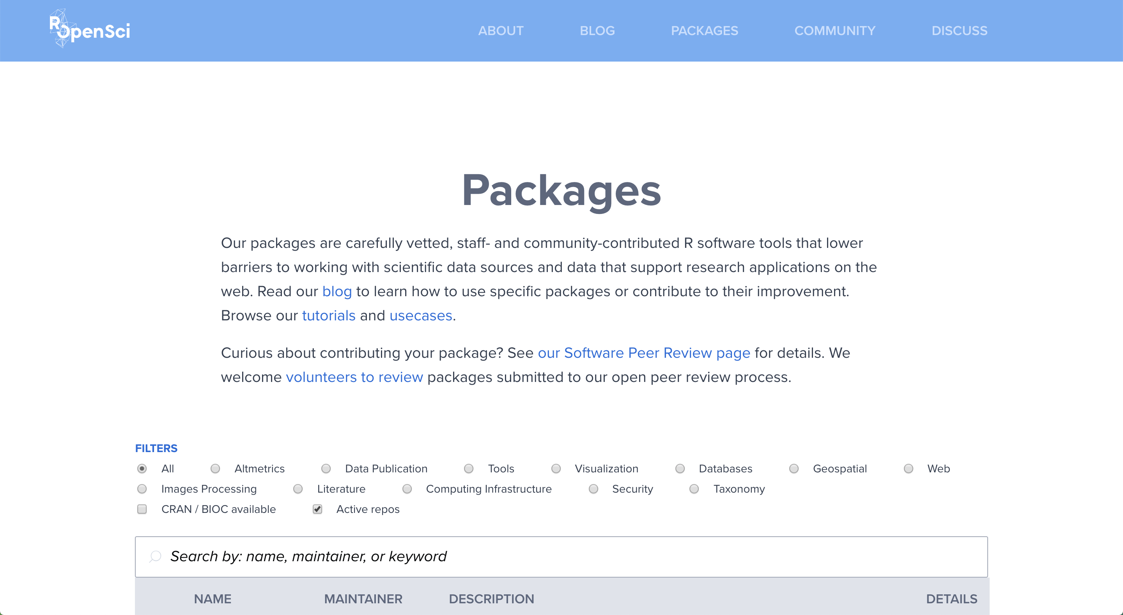

Slide 6
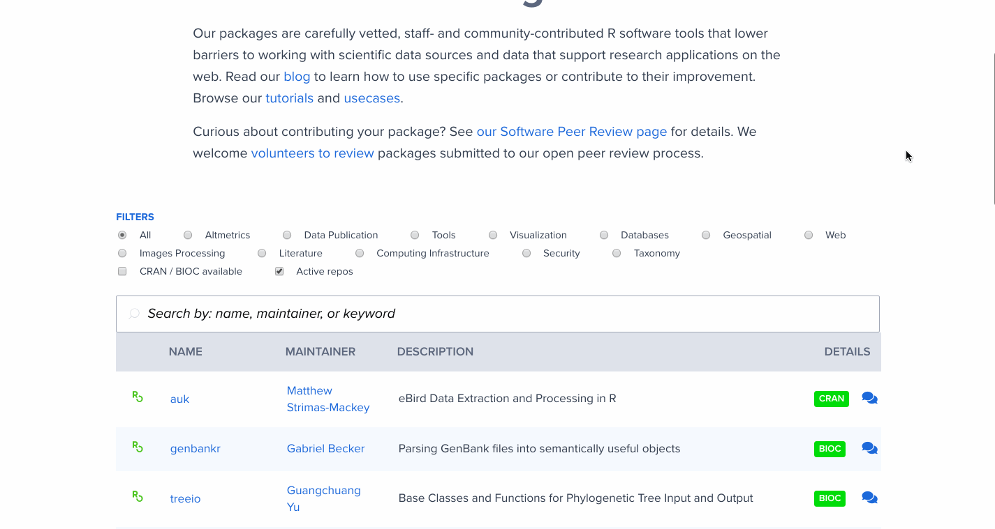
Notes:
ROpenSci is really a large body of volunteers. Lots of people contributing to our collection, can't do it ourselves.

Slide 7
(Production) Code Review | (Academic) Peer Review
granular | project-wide
narrow scope | broad scope
project collaborators | (anonymous) peers in your field
quality control | quality + legitimacy

Slide 8
Why peer review?
drive adoption of best practices and standards
increase quality in the long tail of applications
build a community of practice

Slide 9
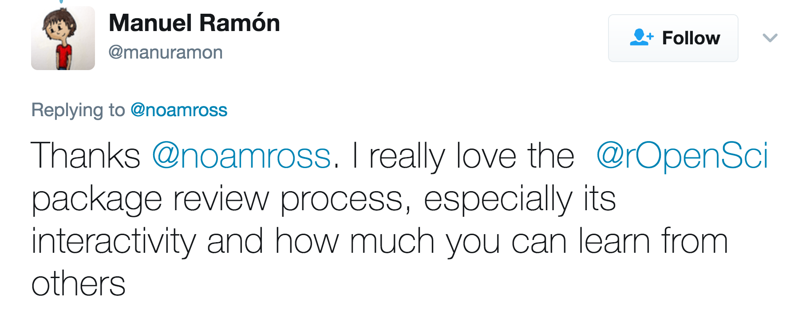
Why peer review?
drive adoption of best practices and standards
increase quality in the long tail of applications
build a community of practice
"The review process taught me a lot about different tools available for making my code more robust and resilient to future changes."
"I learn a lot from closely reading other people's code and it is hard to do when I'm not forced to review so closely."

Slide 10
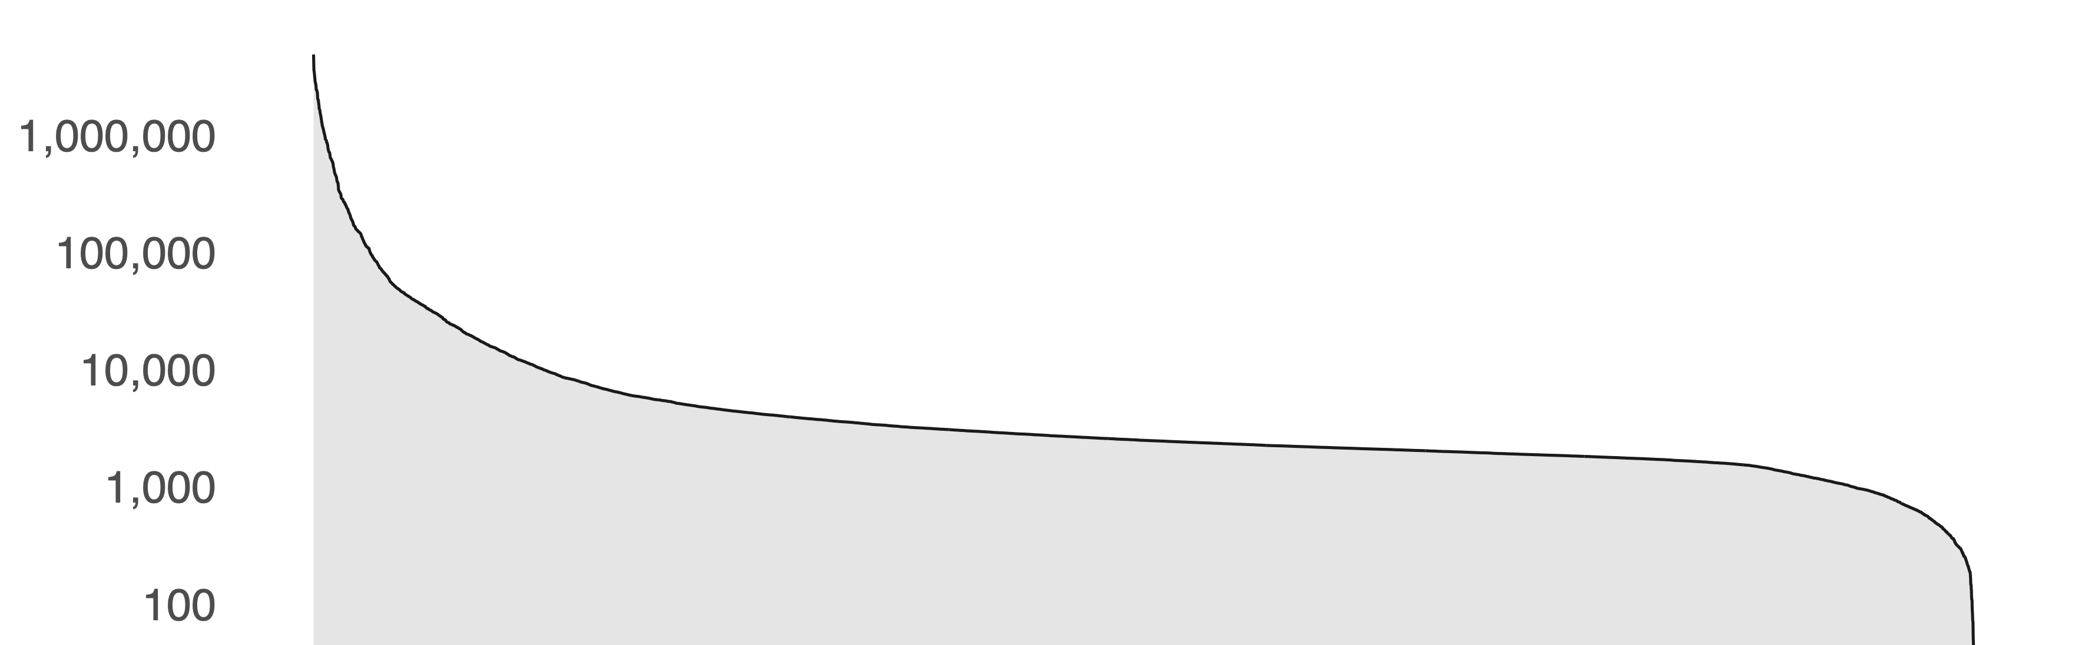
Why peer review?
drive adoption of best practices and standards
increase quality in the long tail of applications
build a community of practice
the long tail: monthly downloads of all CRAN packages

Slide 11
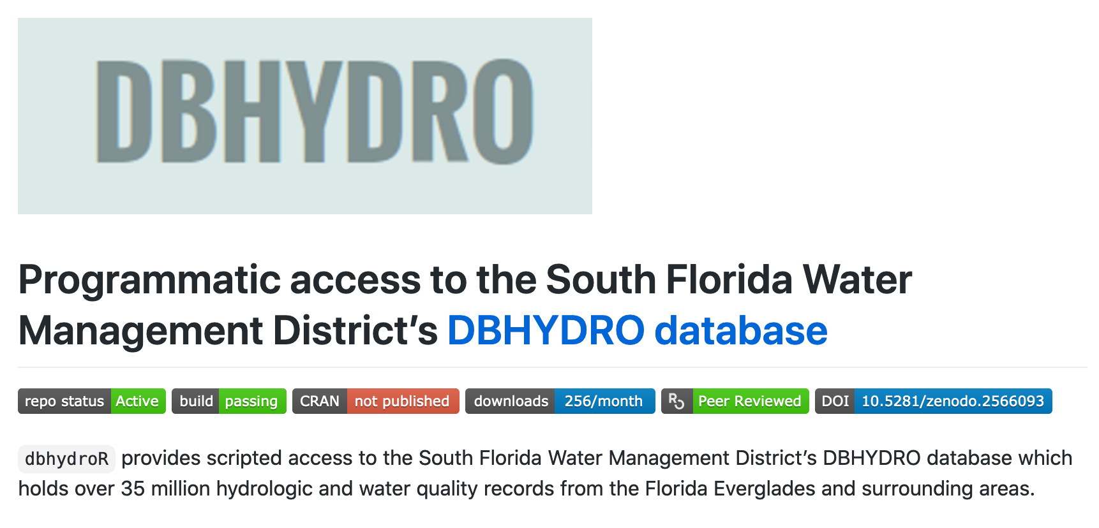
Why peer review?
drive adoption of best practices and standards
increase quality in the long tail of applications
build a community of practice

Slide 12
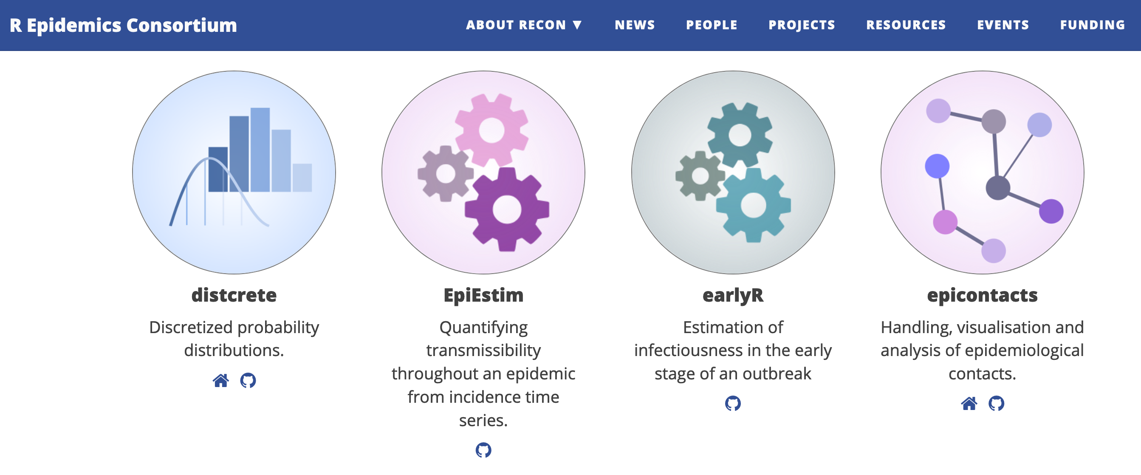
Why peer review?
drive adoption of best practices and standards
increase quality in the long tail of applications
build a community of practice

Slide 13
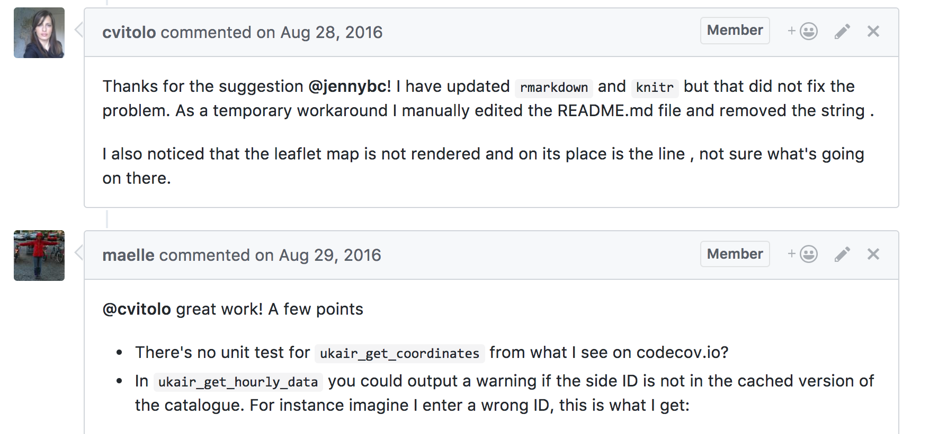
Why peer review?
drive adoption of best practices and standards
increase quality in the long tail of applications
build a community of practice

Slide 14
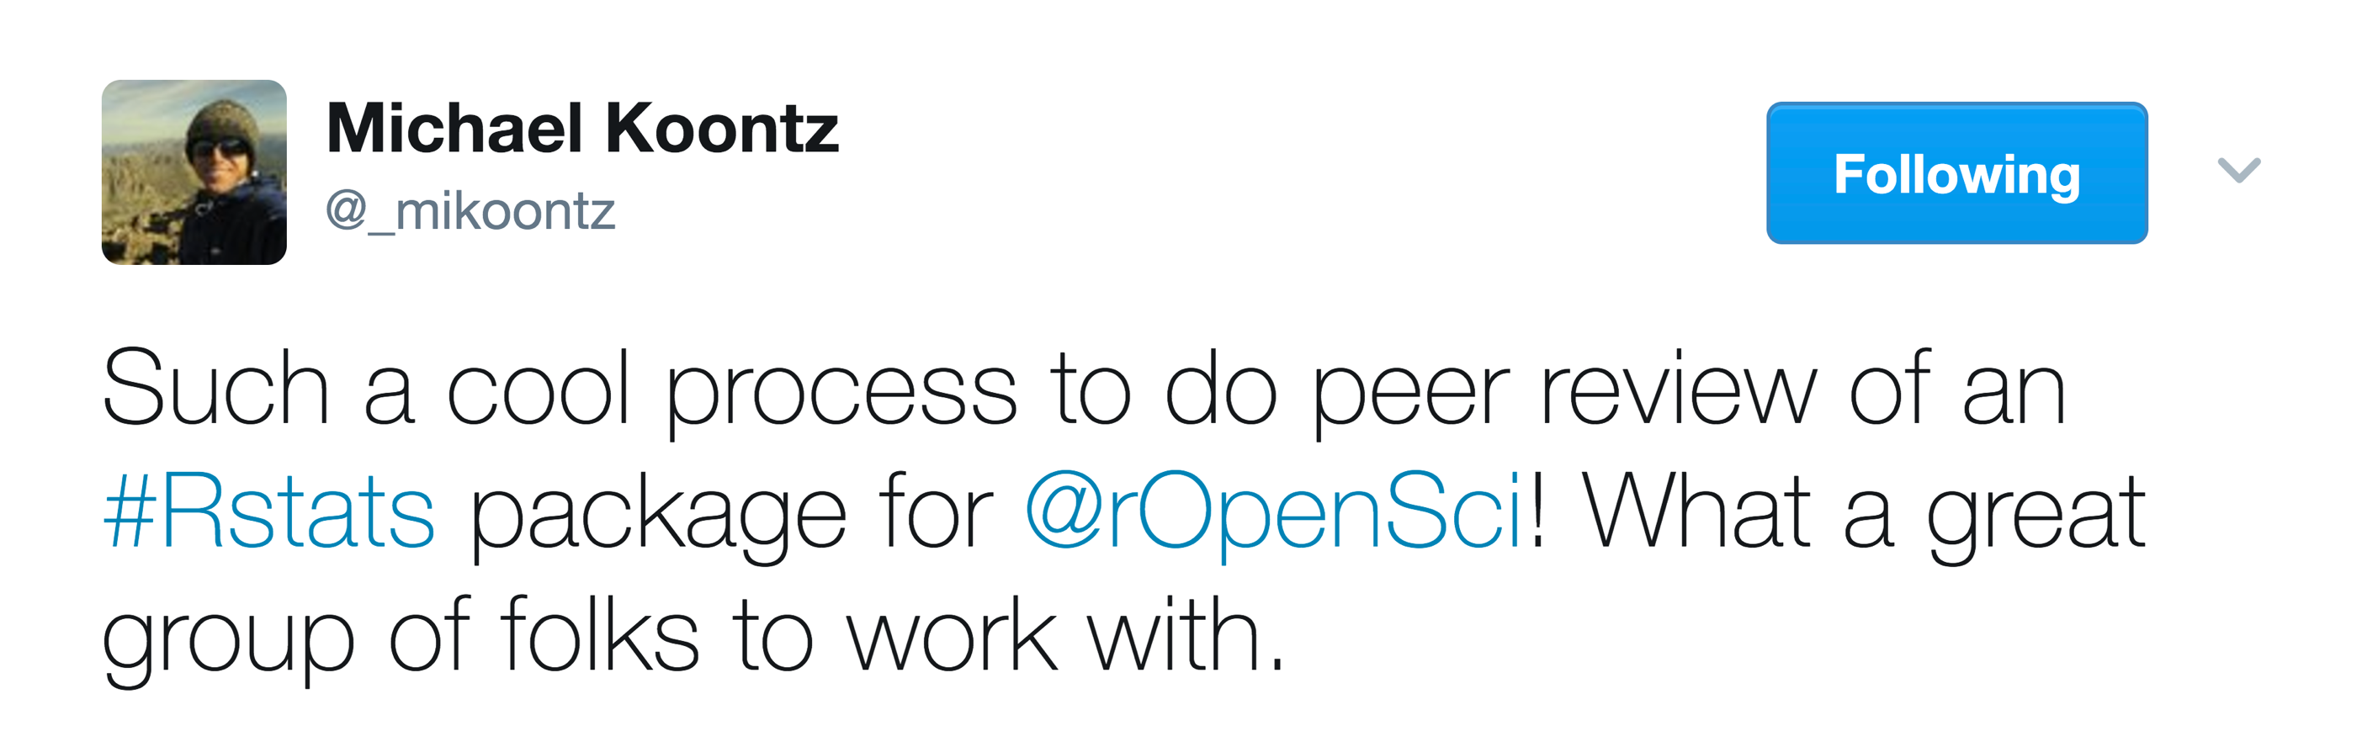
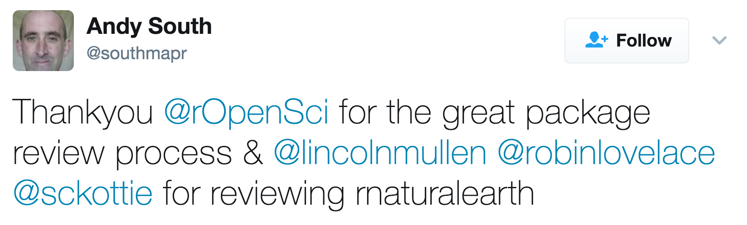
Why peer review?
drive adoption of best practices and standards
increase quality in the long tail of applications
build a community of practice
"[I liked] meeting people in the R community who I didn't know before, and strengthening ties to the community."

Slide 15
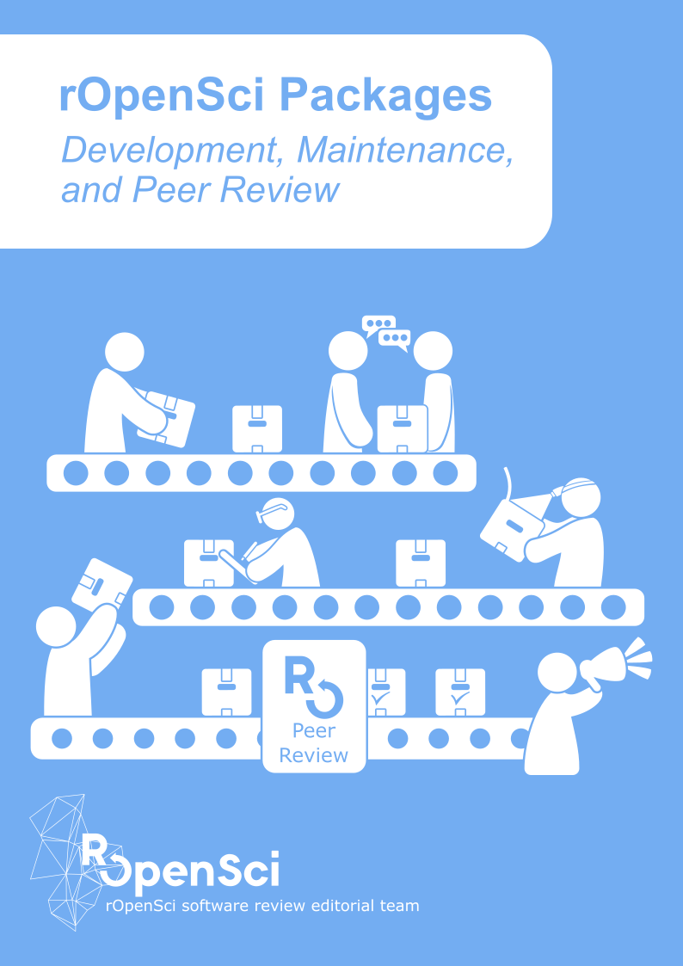
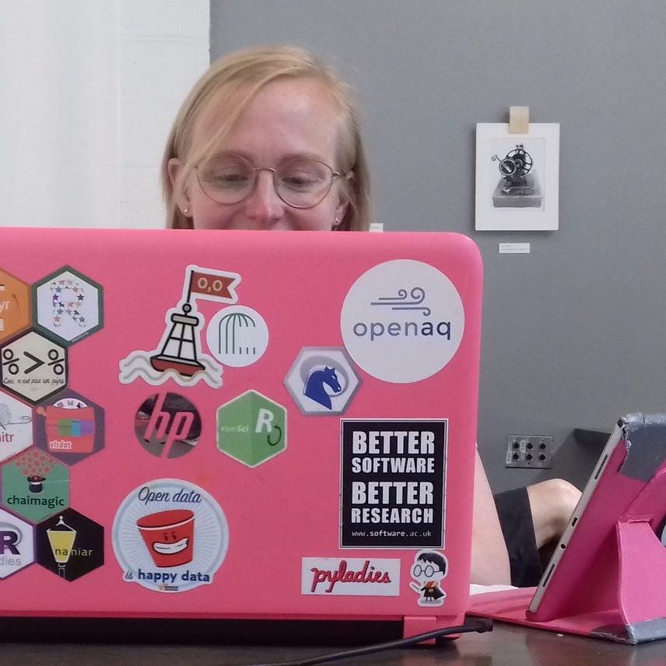
Document standards, processes, and guidance.
Iterate.
devguide.ropensci.org
Maëlle
Salmon
@ma_salmon

Slide 16
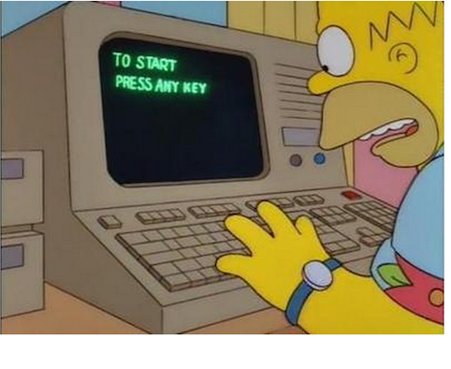
Build review around what users really care about
Documentation
> Usability
> Performance
> Features

Slide 17
Build review around what users really care about
Documentation
> Usability
> Performance
> Features
Installation

Slide 18
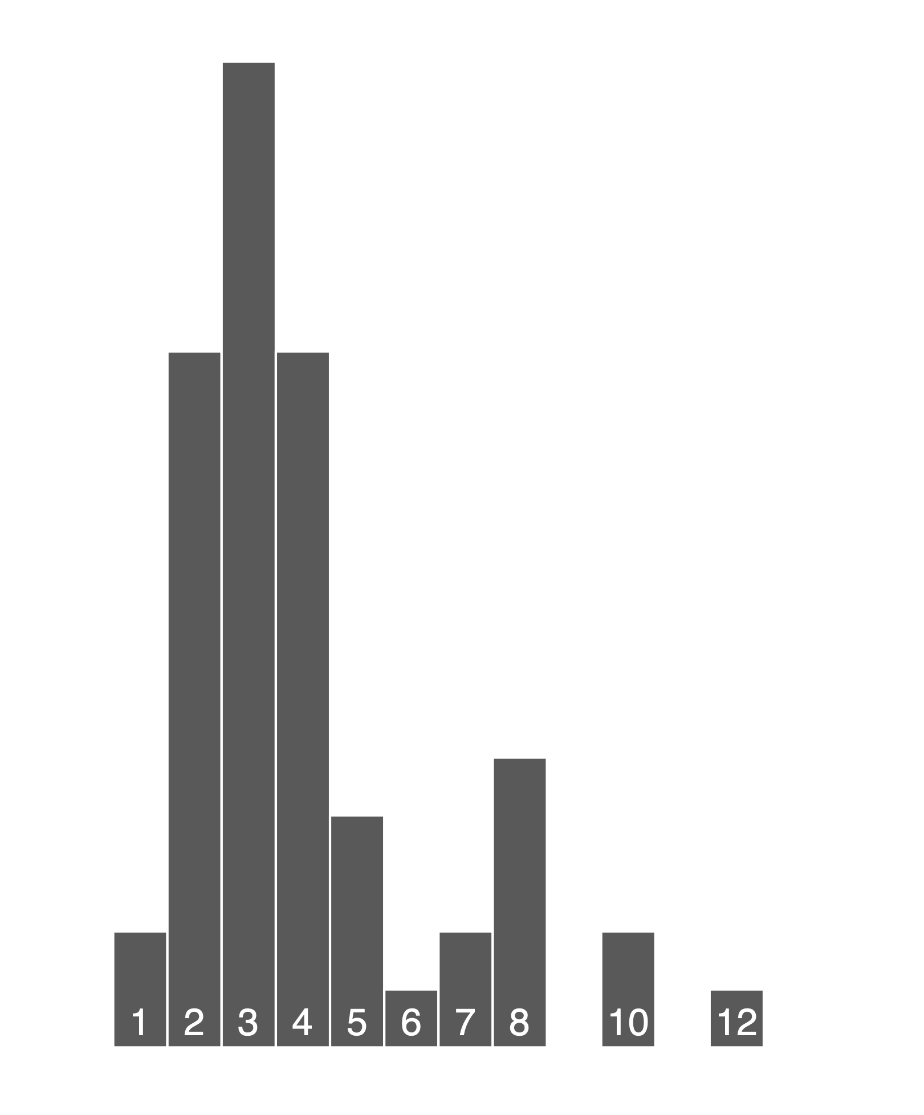
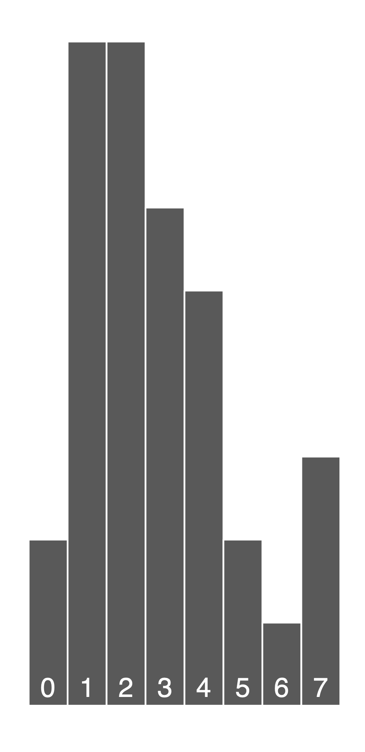
Volunteer time and energy are the most precious resource
Hours for first-round review of an
R package
Months from submittal to approval

Slide 19
What next? Serving Package Authors at Scale
Automated documentation
Uncovering software citations
Building user communities
Simpler and smoother reviews
Internationalization
Expanding the package universe

Slide 20
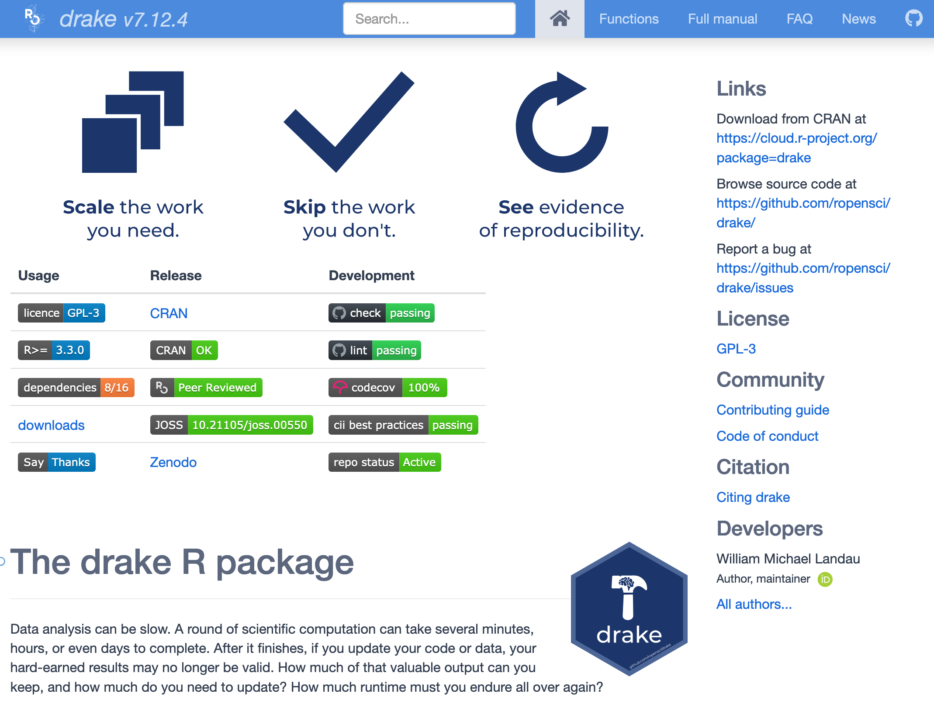
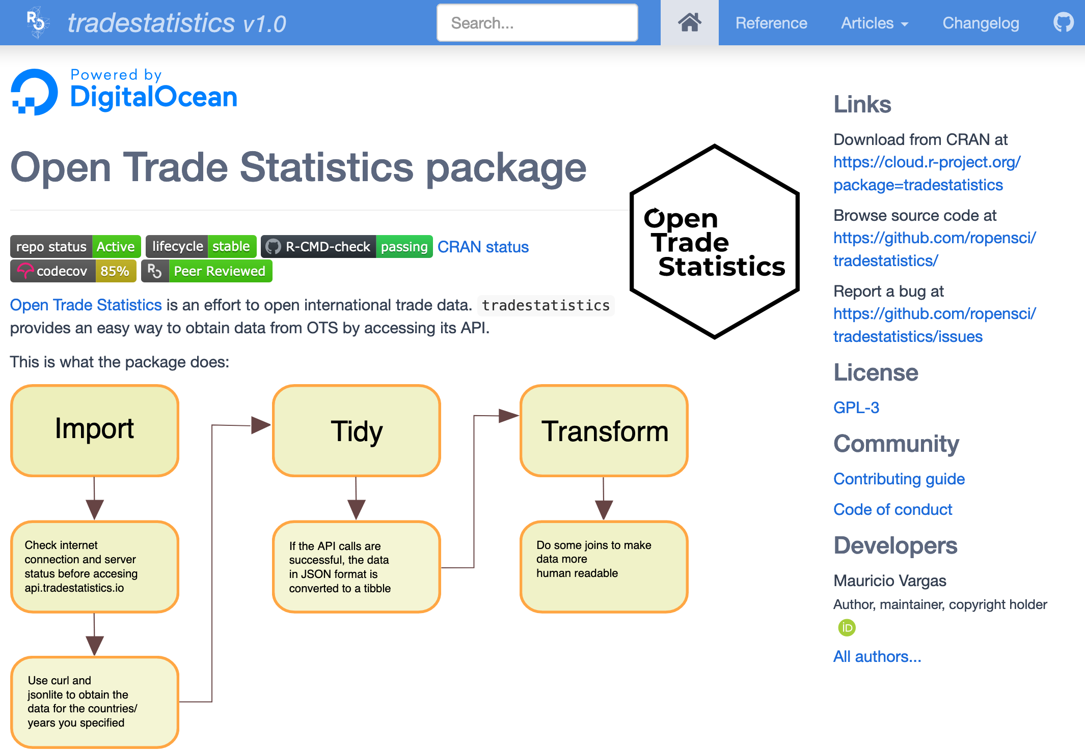
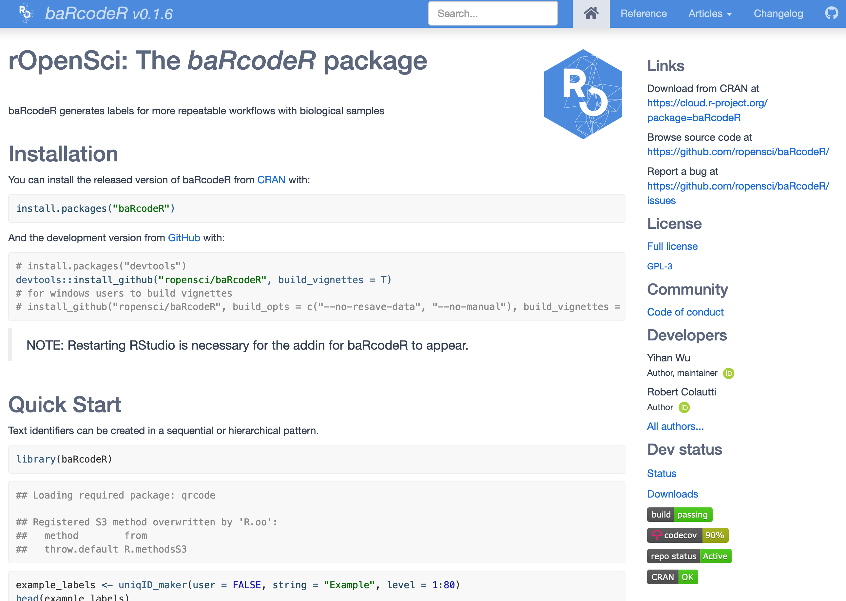
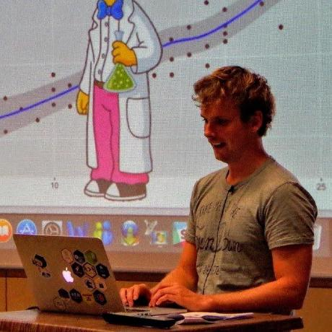
Automating and serving package documentation
docs.ropensci.org
Jeroen Ooms
@opencpu

Slide 21
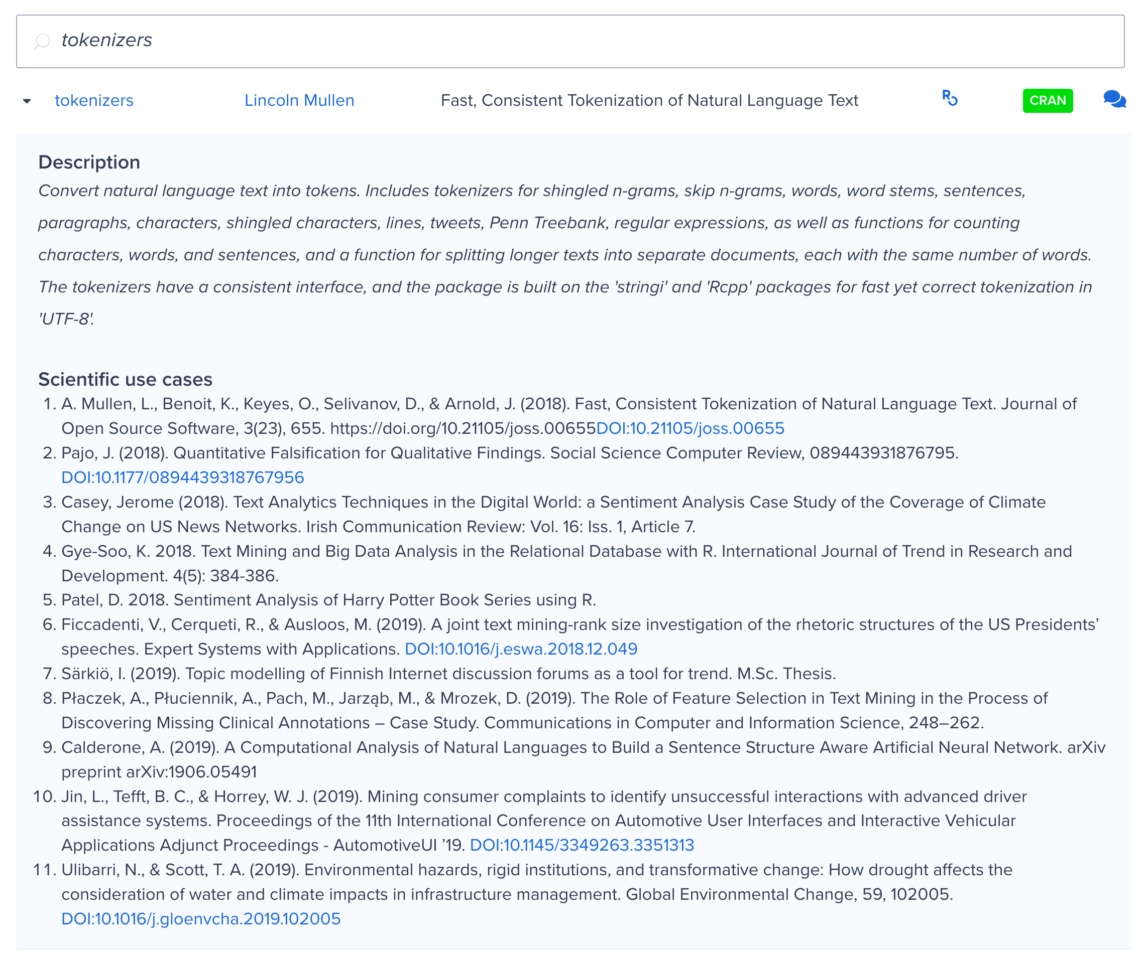
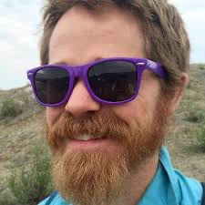
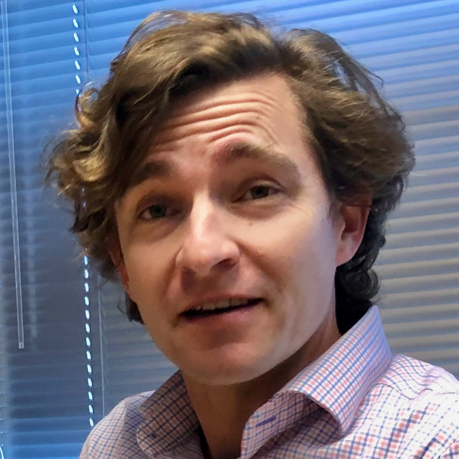
Uncovering software citations
ropensci.org/packages
Scott
Chamberlain
@sckottie
James
Howison
@jameshowison

Slide 22
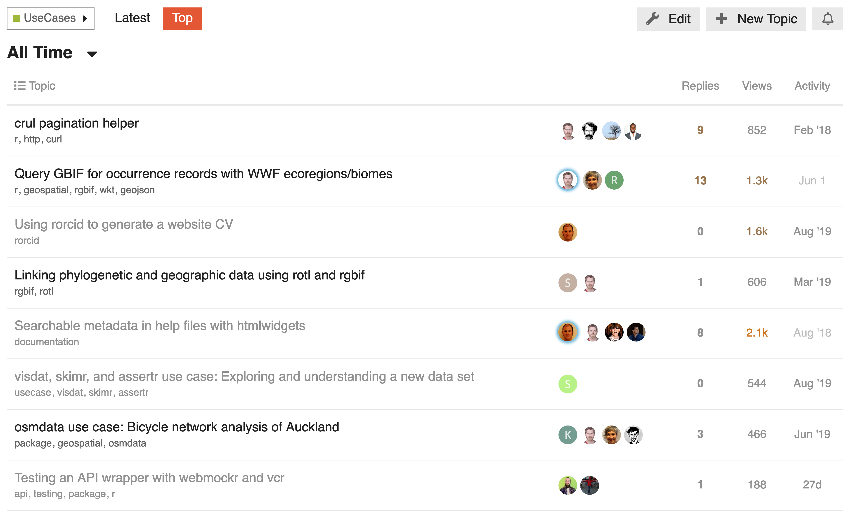
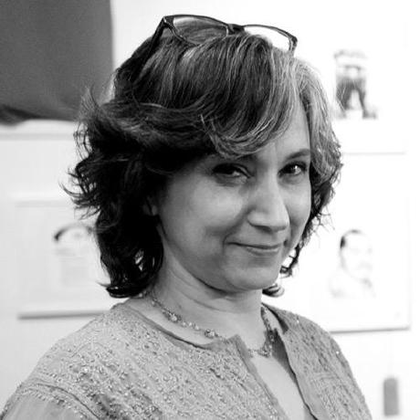
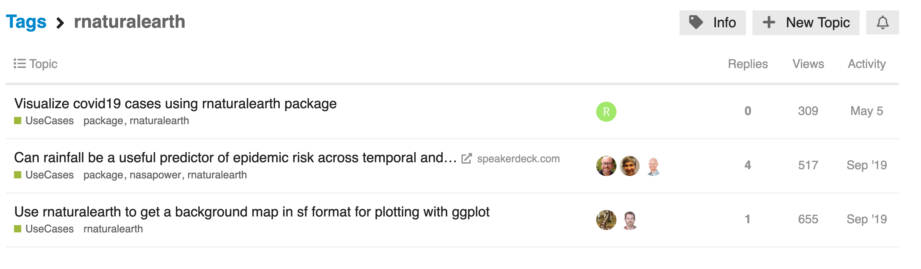
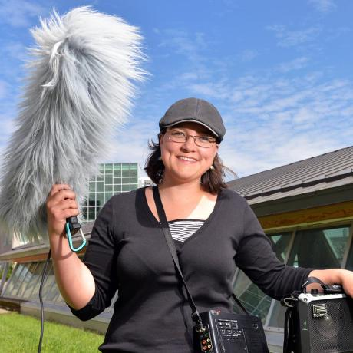
Building a community of users and examples
discuss.ropensci.org
Stefanie
Butland
@stefaniebutland
Steffi
LaZerte
@steffilazerte

Slide 23
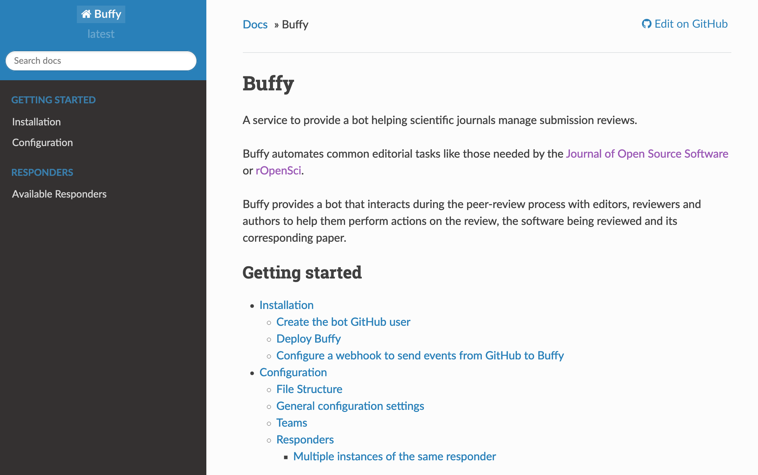
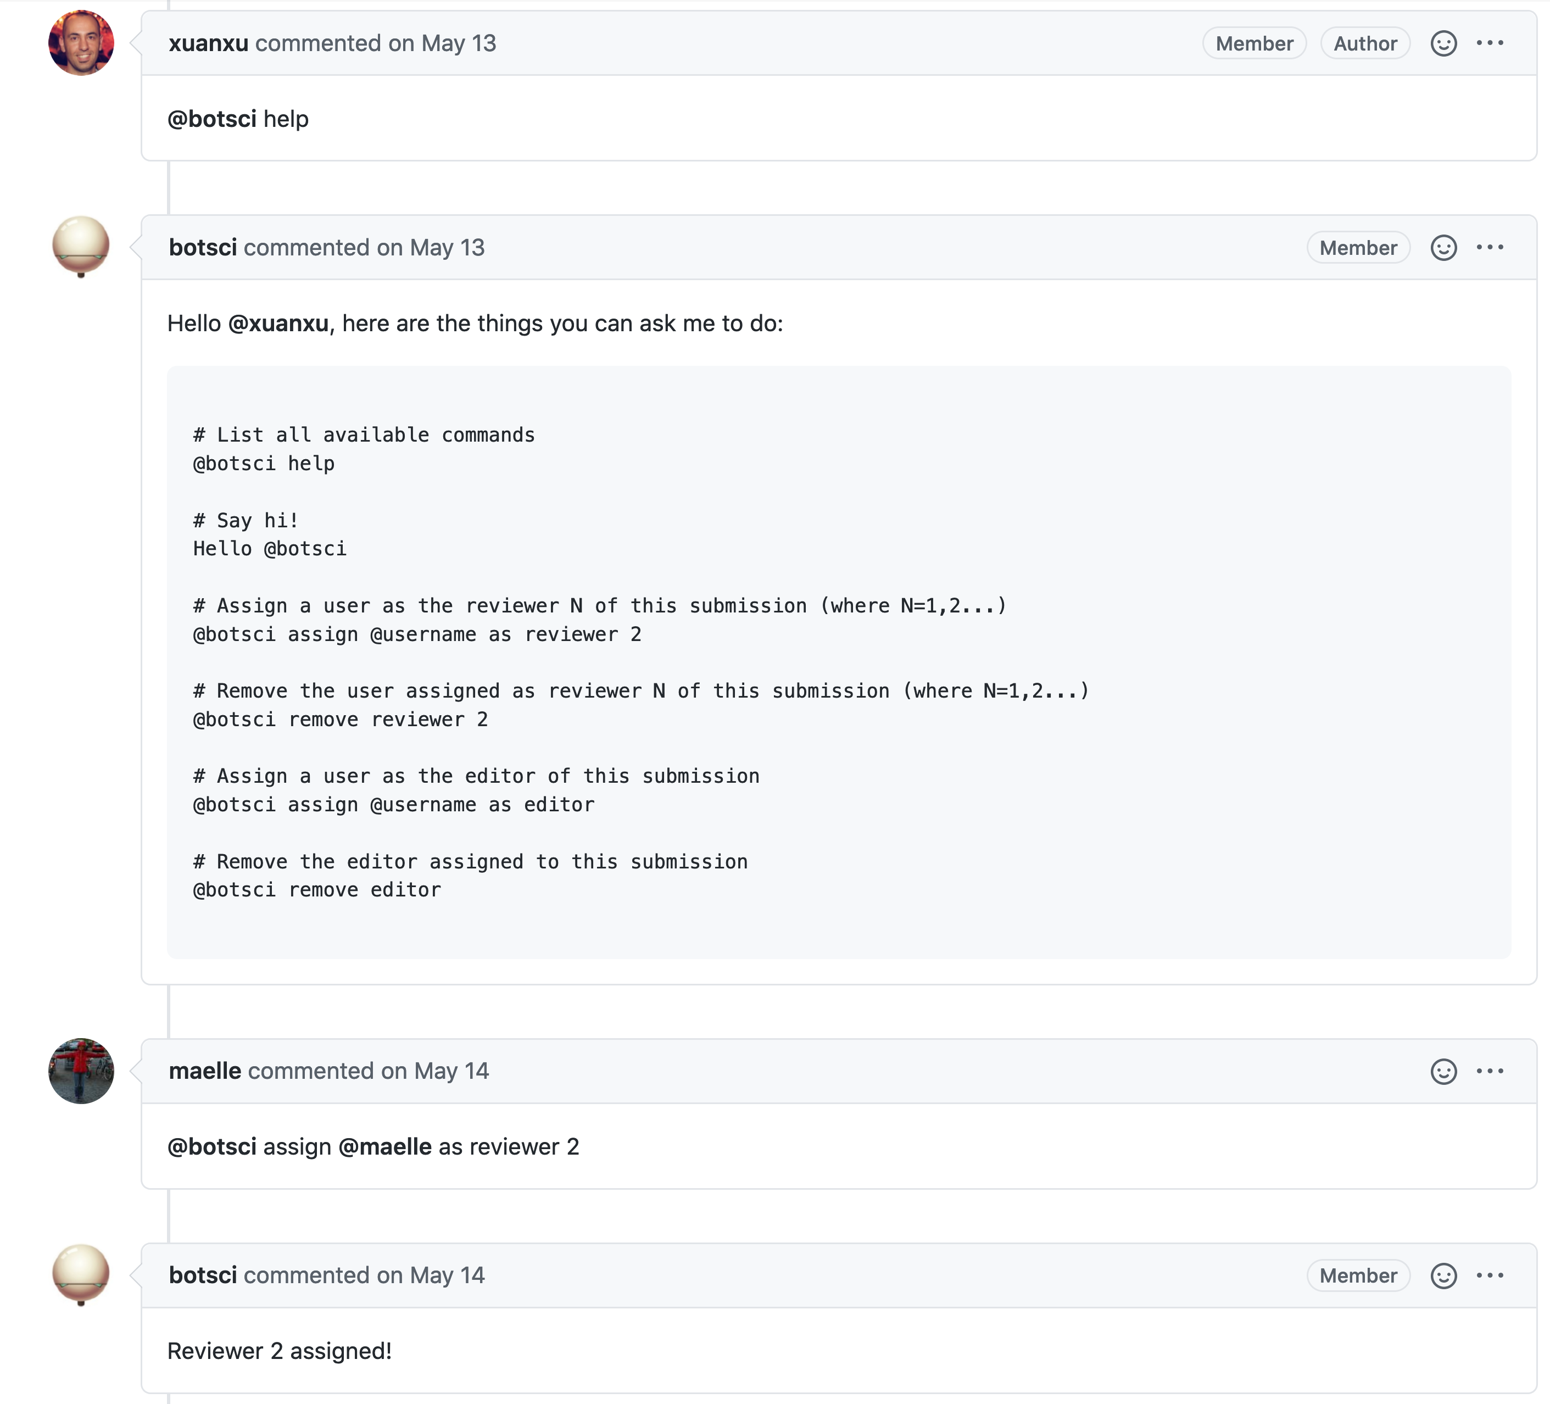
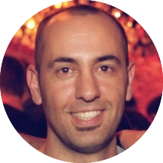
Making review simpler with chatbots
buffy.readthedocs.io
Juanjo
Bazán
@xuanxu

Slide 24
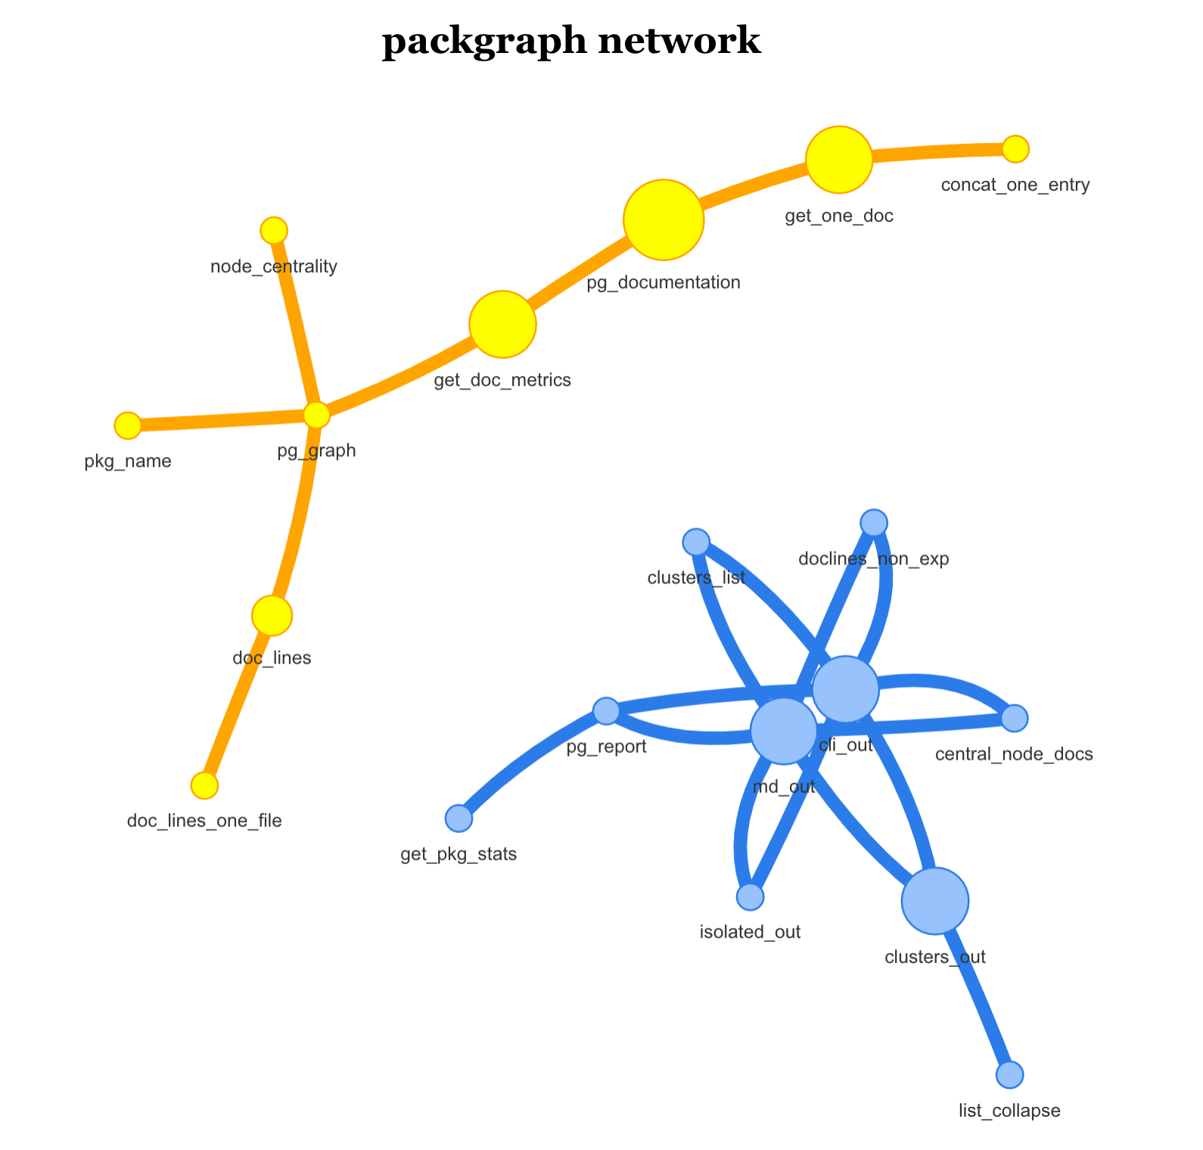
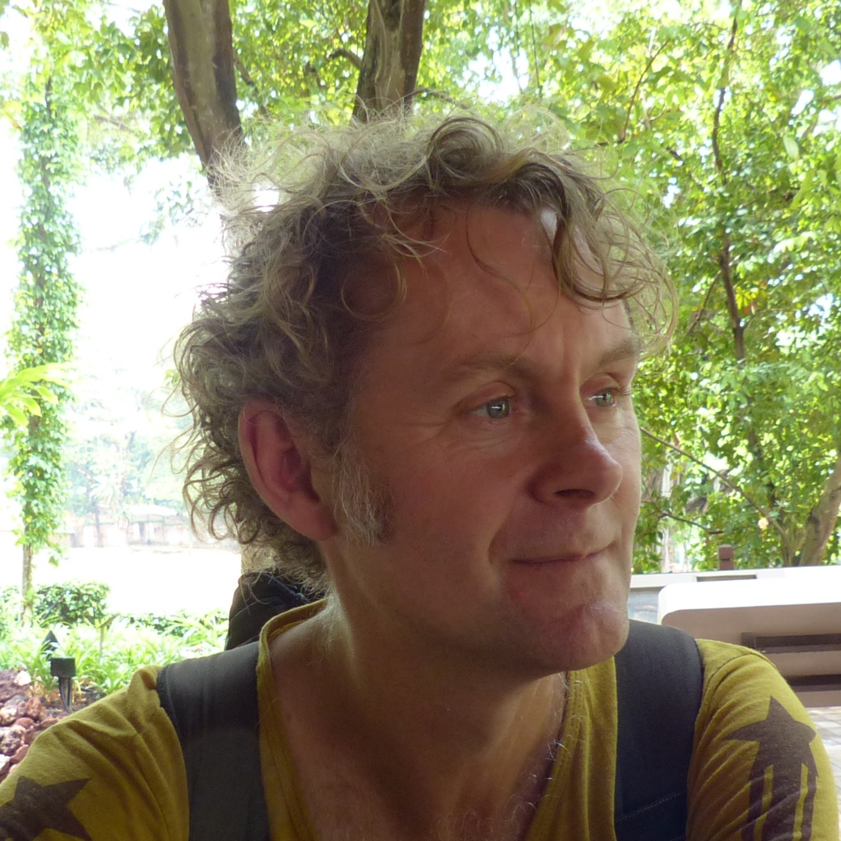
Making review easier with diagnostics
github.com/
mpadge/packgraph
Mark
Padgham
@bikesRdata

Slide 25
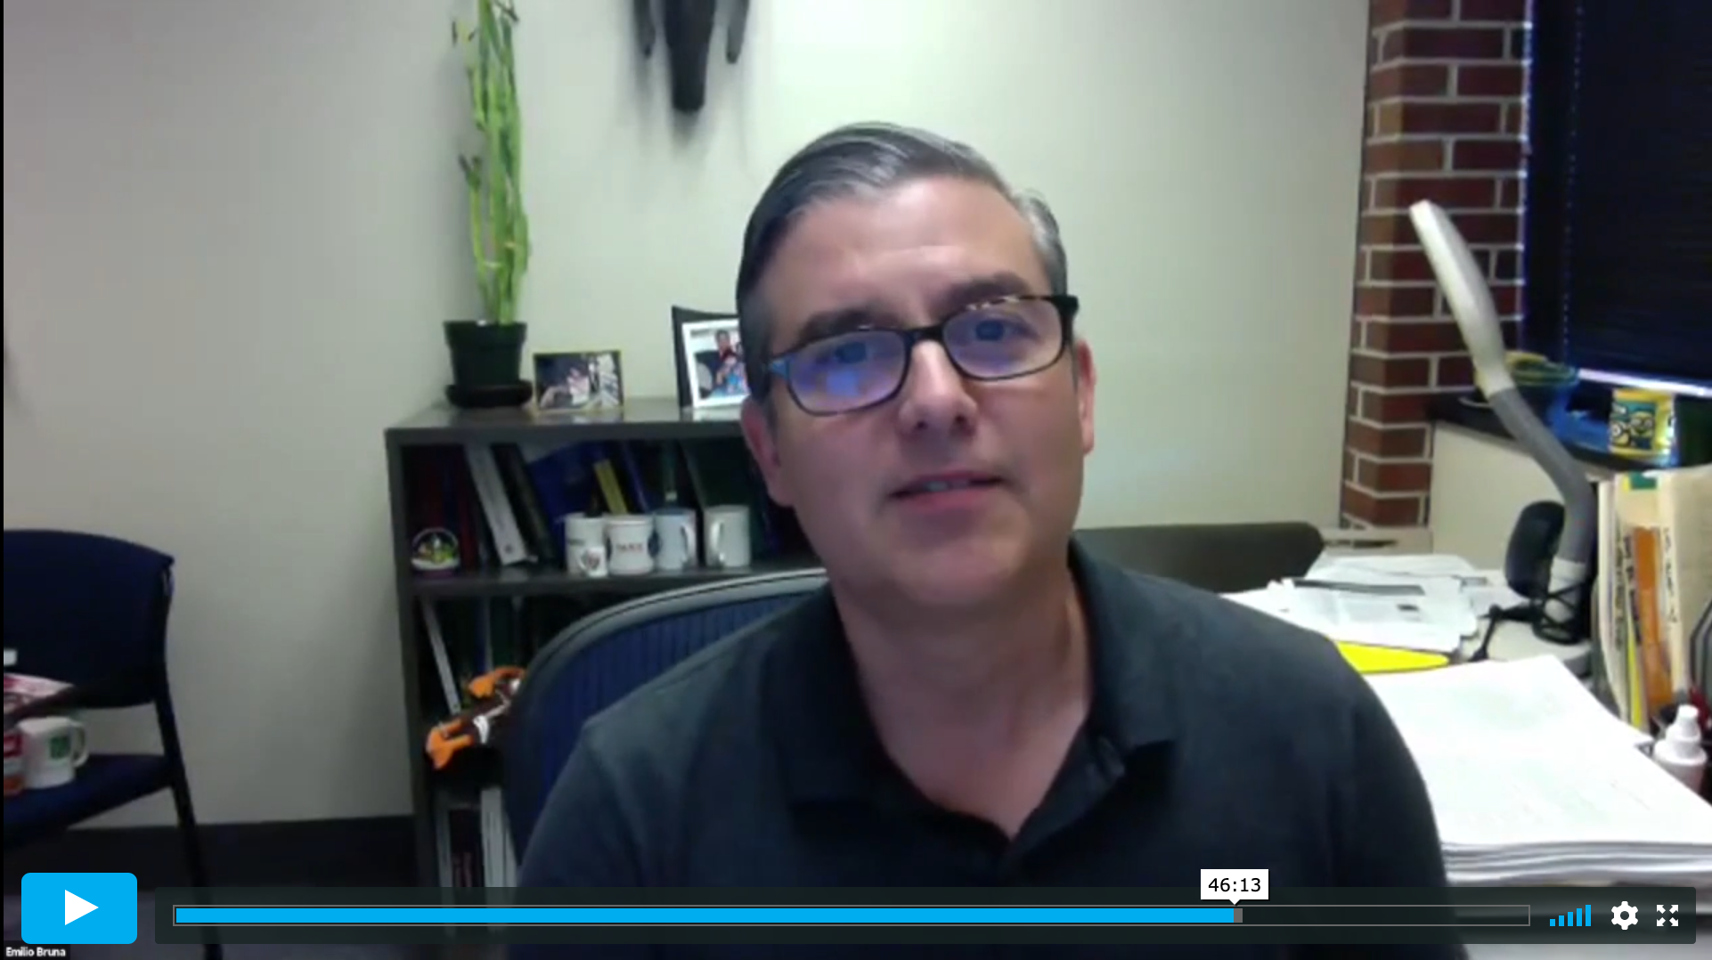
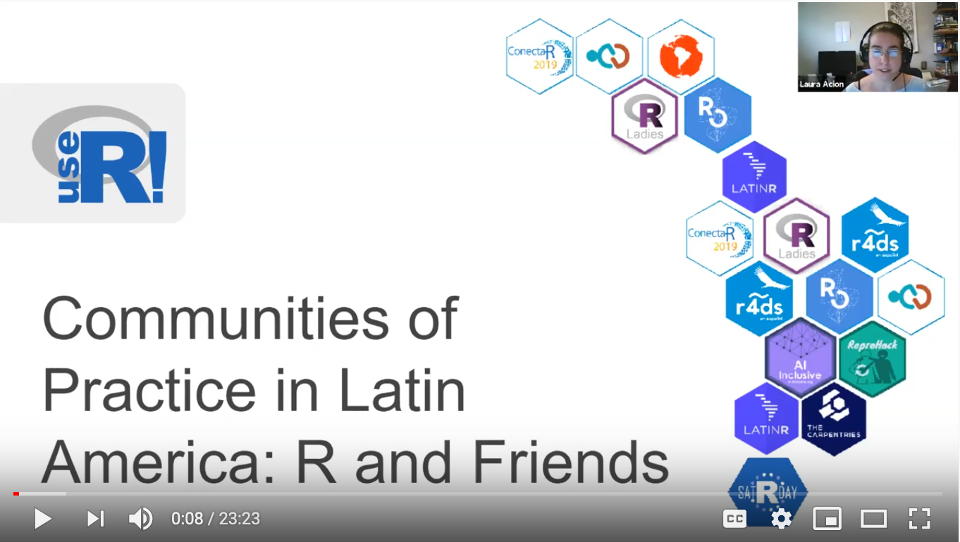
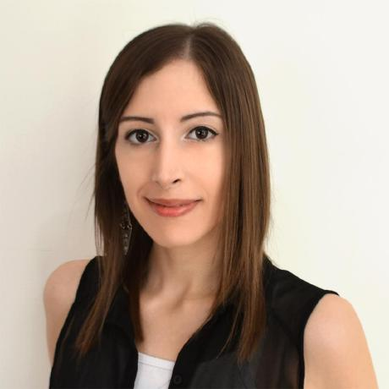
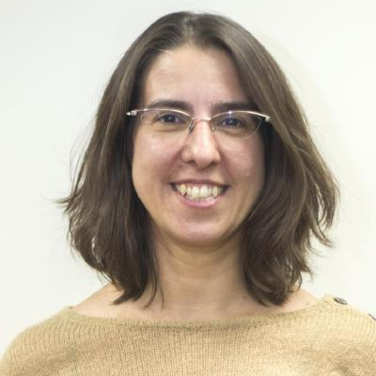
Internationalization and expanding to multilingual communities
ropensci.org/commcalls
Melina
Vidoni
@melvidoni
Laura
Ación
@_lacion_

Slide 26
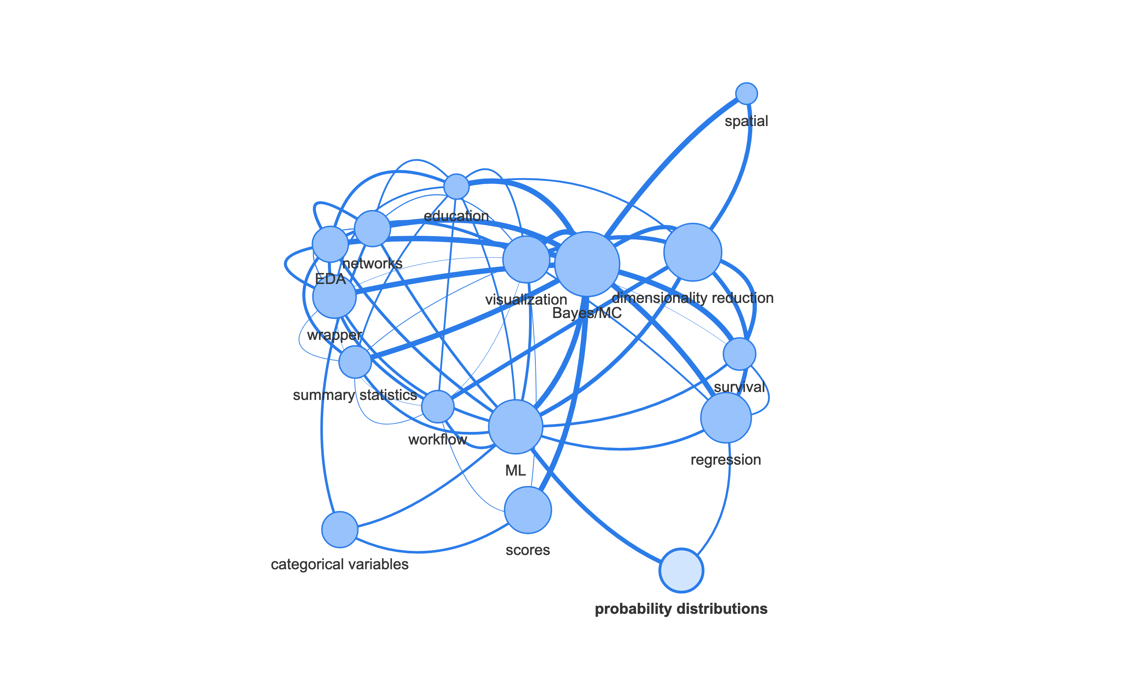
Expanding into the statistical package universe
ropenscilabs.github.io/statistical-software-peer-review
Mark
Padgham
@bikesRdata

Slide 27
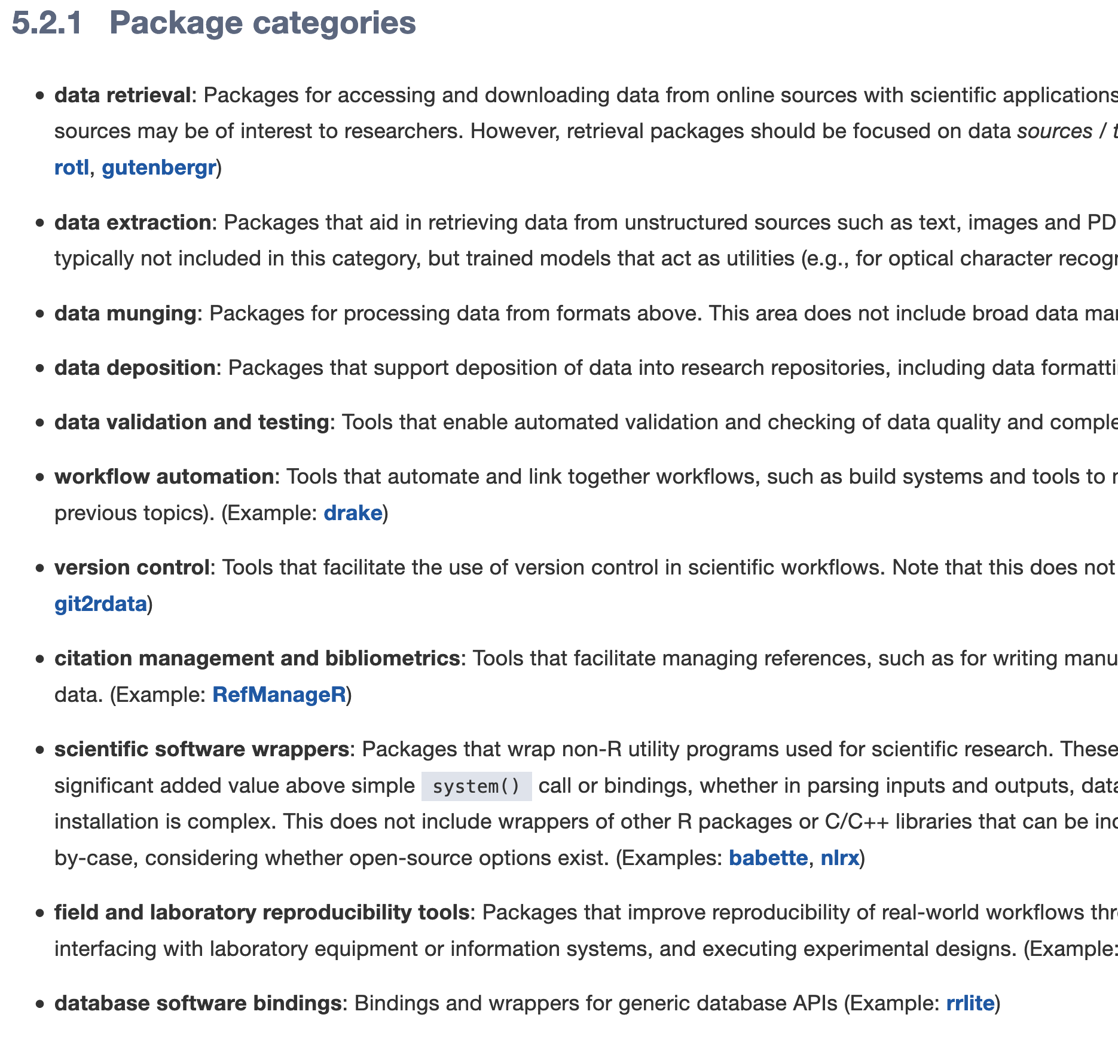
Expanding into the statistical package universe
ropenscilabs.github.io/statistical-software-peer-review
Mark
Padgham
@bikesRdata

Slide 28
Expanding into the statistical package universe
ropenscilabs.github.io/statistical-software-peer-review
Mark
Padgham
@bikesRdata

Slide 29










Building modular, intercompatible standards
Journal of Open Source Software
R Validation Hub
Mozilla Science
Stan Development Team

Slide 30
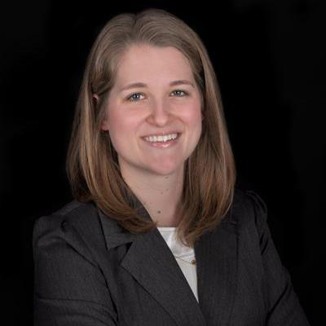
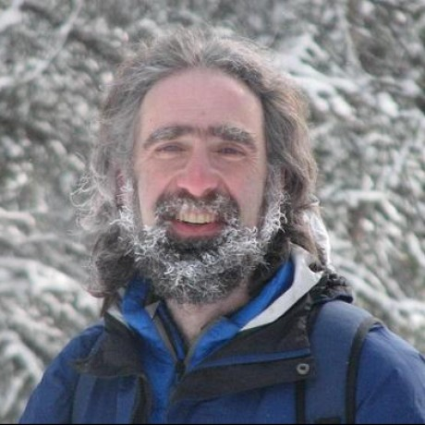
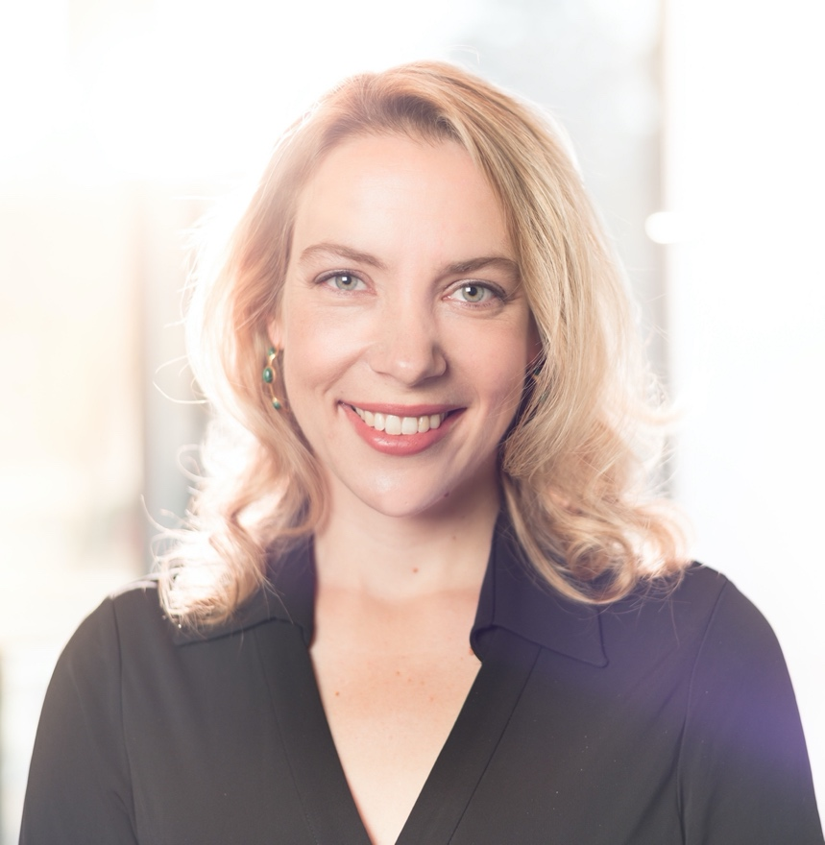
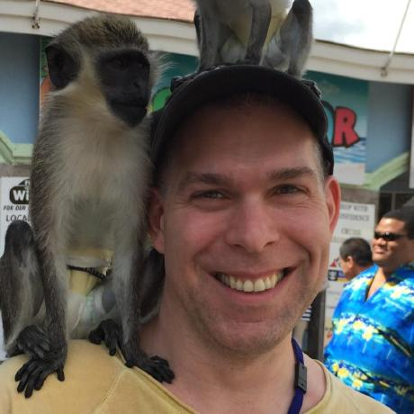
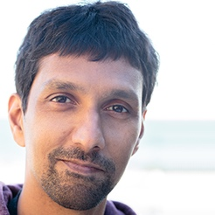
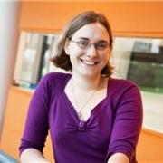
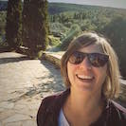
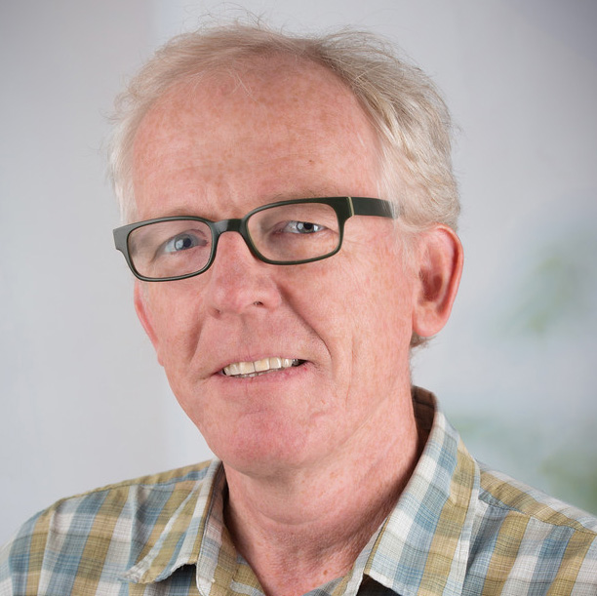
The editorial
team
Stephanie
Hicks
@stephaniehicks
Brooke
Anderson
@gbwanderson
Ben Bolker
@bolkerb
Max Kuhn
@topepos
The statistical advisory board
Karthik
Ram
@_inundata
Rebecca
Killick
gh:rkillick
Anna
Krystalli
@annakrystalli
Maëlle
Salmon
@ma_salmon
Martin
Morgan
gh:mtmorgan
Melina
Vidoni
@melvidoni

Slide 31
What
How
Algorithm correctness
Documentation of assumptions and limitations
API standardization and transparency
Robust architectural and dependency choices
Testing completeness
Accept / Reject like a journal?
Self-Certification step?
Bronze/Silver/Gold Rating?
Reviewer training?
What tooling can support scaffolding and testing?

Slide 32
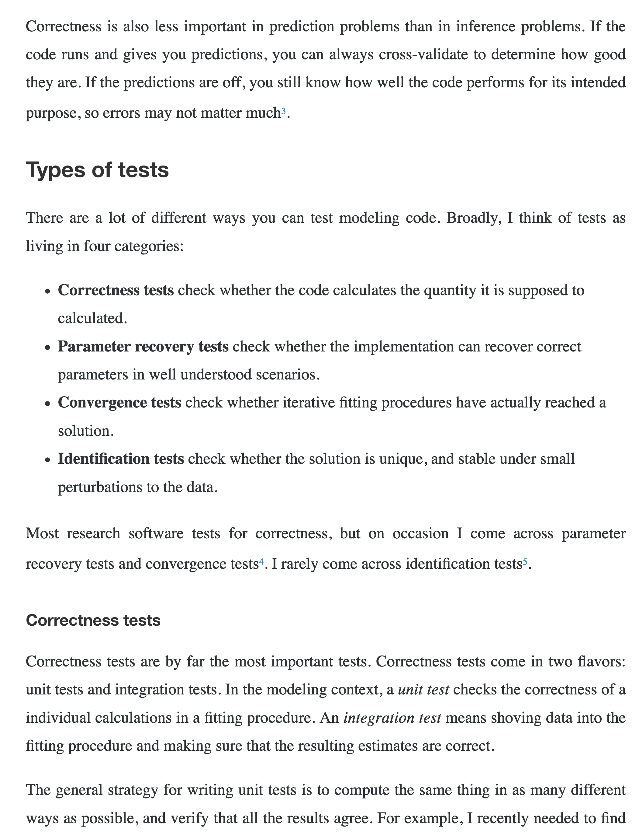

What does a robust test suite for a statistical package look like?
alexpghayes.com/blog/
testing-statistical-software/
Alex Hayes
@alexpghayes

Slide 33
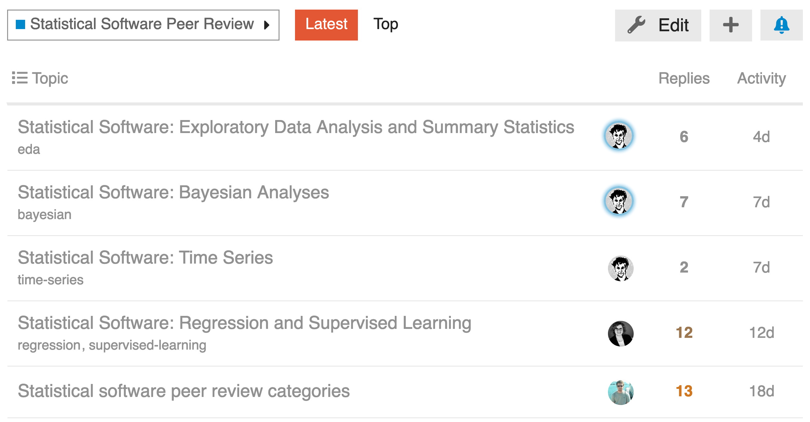
discuss.ropensci.org/statistical-software-peer-review

Slide 34


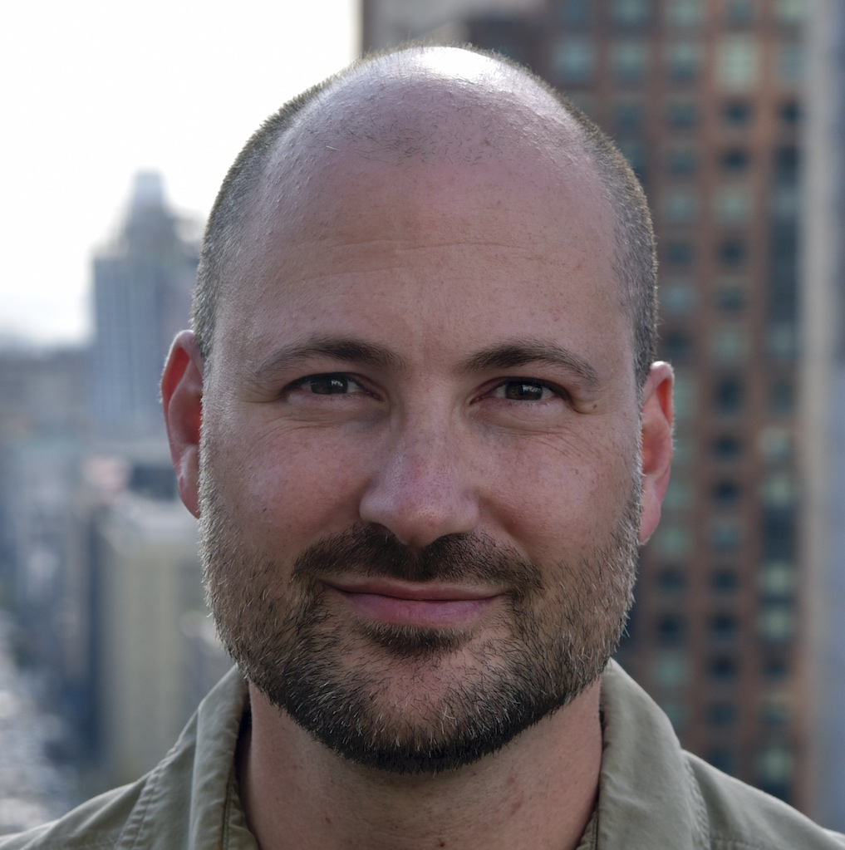


Thank you!
@rOpenSci
ropensci.org
Join the conversation:
discuss.ropensci.org
Sign up as a reviewer:
ropensci.org/onboarding
Submit a package:
github.com/ropensci/software-review
Slides/Links: bit.ly/NoamUseR
Noam Ross
@noamross

